Slide 1
L4,L5,L6

Slide 2
Anonymous function
An anonymous function is a function without a name.
Regular functions are defined using the def keyword. Similarly, anonymous functions are defined by using the lambda keyword.
So, anonymous functions can also be referred to as lambda functions.
The syntax of a lambda function in Python:
lambda arguments: expression
Features of lambda function:
They can be used anywhere we need regular function objects.
They can have many arguments but can have only one expression.
The expression is evaluated first and a value is returned.

Slide 3
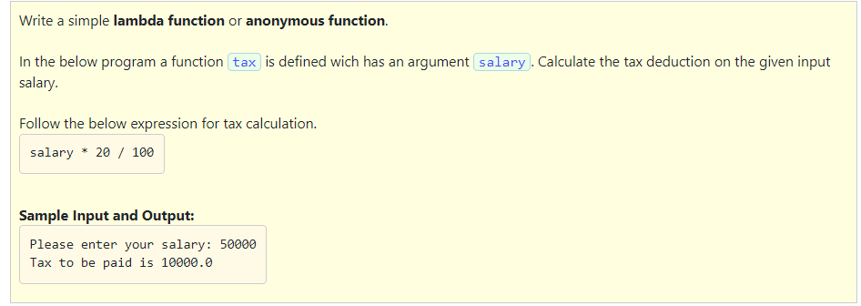

Slide 4
Solution:
tax = lambda salary: salary * 20 / 100
salary = int(input("Please enter your salary: "))
print("Tax to be paid is", tax(salary))

Slide 5
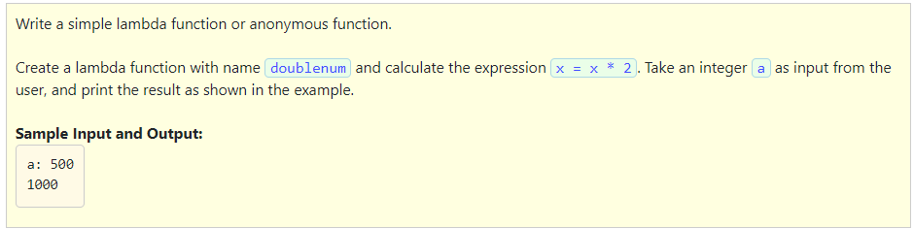

Slide 6
Solution:
doublenum = lambda x: x * 2
a = int(input("a: "))
print(doublenum(a))

Slide 7
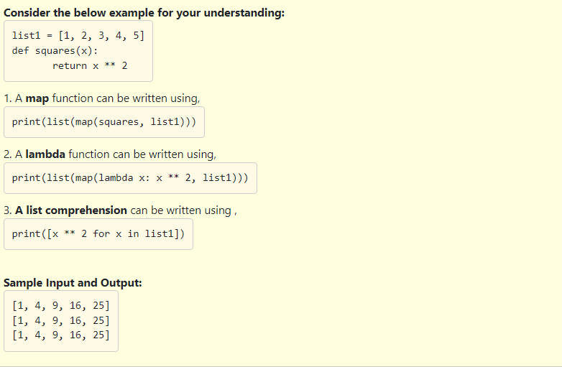
Map function:
The map(f, sequence) function applies a function f to each element of a sequence and returns a transformed list.
If a sequence = [a1, a2, a3, a4,....,an] and a function f is given, then
map(f, sequence) => iterator over [f(a1), f(a2), f(a3),....,f(an)]
Follow the instructions given in comment lines and write the missing code in the given program.

Slide 8
Solution:
def squares(x):
return x ** 2
list1 = [1, 2, 3, 4, 5]
#using the squares func inside map function
print(list(map(squares,list1)))
#using the lambda func inside map function
print(list(map(lambda x: x ** 2, list1)))
#using list comprehension to get equivalent behaviour as map
print([x ** 2 for x in list1])

Slide 9
The filter(f, sequence) function applies the function f to each element in the sequence.
This function returns an iterator to a sequence of elements where each element satisfies the condition in the function f.
Let's consider an example:
consider two lists
a = [1, 2, 3, 5, 7, 9]
b = [2, 3, 6, 7, 9, 8]
The filter function can be applied by using lambda function.
print(list(filter(lambda x : x in a, b)))
A list comprehension can be written using :
print([x for x in a if x in b])

Slide 10
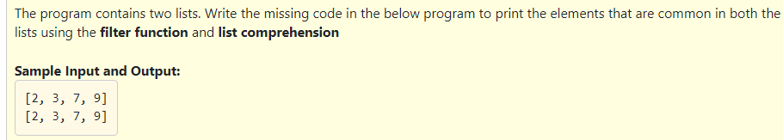
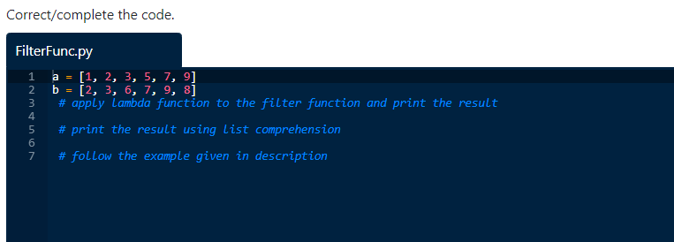

Slide 11
Solution:
a = [1, 2, 3, 5, 7, 9]
b = [2, 3, 6, 7, 9, 8]
print(list(filter(lambda x : x in a, b)))
print([x for x in a if x in b])

Slide 12
Fruitful functions:
A fruitful function is a function which returns value using a return statement.
If we want a function to return a value to the statement that called the function, then the return statement is used.
To reiterate what we learnt before, a return statement consists of the return keyword followed by an expression. This expression is evaluated and returned to the function caller.
Python evaluates a fruitful function and how the function executes a return statement.
The below are the steps involved :
Inside the function body, a return statement with the expression is evaluated to produce a value.
The value is returned back to the caller.
The control from the function that it is executing stops and immediately returns to the location of the caller function.
When the control returns after a return statement and any statement that exists in the executing function after return statement is ignored.
Most of the built-in functions are fruitful functions. Every function is fruitful even if the body does not contain a return statement.
Referring to the previous lessons one can conclude that the function will return a special value called None, which has type NoneType if the function does not have a return statement.

Slide 13
Which of the following is the correct option?
1. A fruitful function is a function, it returns a value when it is called.
2. A return statement consists of the return keyword followed by an expression.
3. Python returns immediately when it reaches a return statement .
4. Any statement after return is executed after the value is returned.
1 and 2
1,2 and 3
1 and 3
3 only

Slide 14
Which of the following is the correct option?
1. A fruitful function is a function, it returns a value when it is called.
2. A return statement consists of the return keyword followed by an expression.
3. Python returns immediately when it reaches a return statement .
4. Any statement after return is executed after the value is returned.
1 and 2
1,2 and 3
1 and 3
3 only

Slide 15
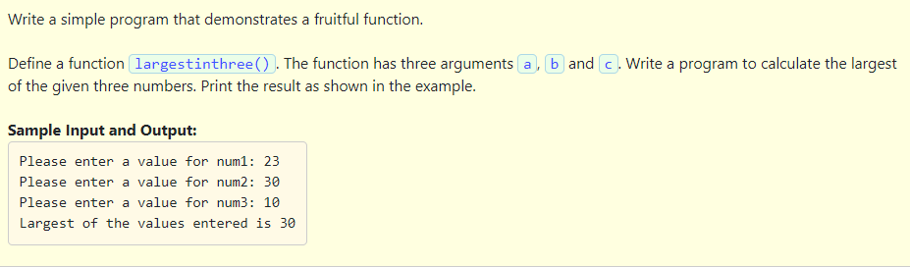
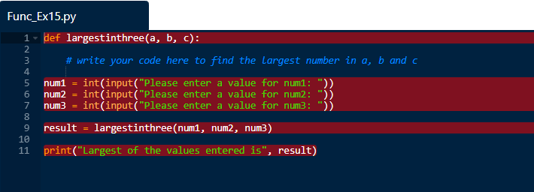

Slide 16
Solution:
def largestinthree(a, b, c):
if a > b and a > c:
return a
elif b > a and b > c:
return b
else:
return c
num1 = int(input("Please enter a value for num1: "))
num2 = int(input("Please enter a value for num2: "))
num3 = int(input("Please enter a value for num3: "))
result = largestinthree(num1, num2, num3)
print("Largest of the values entered is", result)

Slide 17
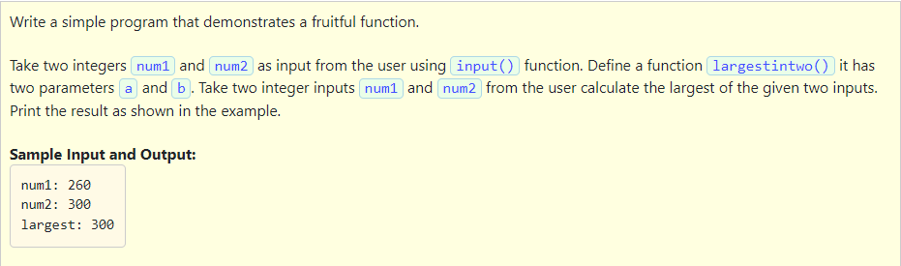
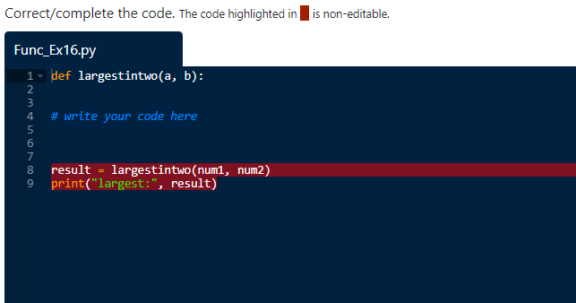

Slide 18
Solution:
def largestintwo(a, b):
if a > b:
return a
else:
return b
num1 = int(input("num1: "))
num2 = int(input("num2: "))
result = largestintwo(num1, num2)
print("largest:", result)

Slide 19
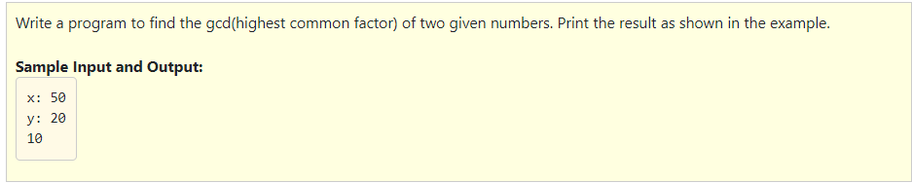
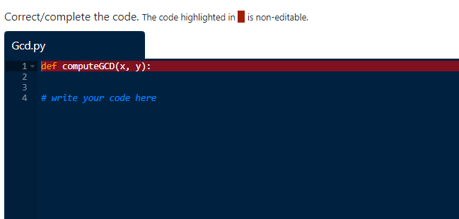

Slide 20
Solution:
def computeGCD(x, y):
if x > y:
small = y
else:
small = x
for i in range(1, small+1):
if((x % i == 0) and (y % i == 0)):
gcd = i
return gcd
a = int(input("x: "))
b = int(input("y: "))
print (computeGCD(a, b))

Slide 21
Global and local variables
Local variables
A local variable is declared inside a function.
It is visible only inside their function, only statements inside function can access that local variable.
They are declared only after the start of the execution of the function.
It gets destroyed when control exits the function.

Slide 22
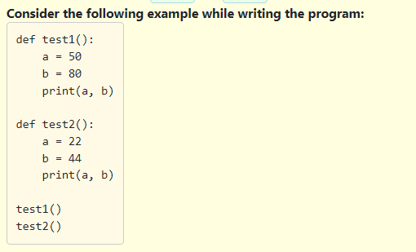
Follow the given instructions and write the program:
Define a function test1
Define local variables a, b and initialize them with values 50, 80 respectively
Print a, b
Define another function test2
Define local variables a, b and initialize them with values 22, 44 respectively
Print a, b
Call the functions test1 and test2

Slide 23
In the previous code we have a functions test1(), test2() in these functions local variables are declared with same variable names a and b but they are stored in different part of memory and treated as different variables.
When the program is executed:
A call to test1() makes the control pass to test1. Here the local variables of test1() are created.
The print statement of test1 is executed and values printed.
The control returns back ,at this point the local variables of test1 are destroyed.
A call to test2() makes the control pass to test2. Here the local variables of test2() are created.
The print statement of test2 is executed and values printed.
The control returns back ,at this point the local variables of test2 are destroyed.

Slide 24
Global variables:
A global variable is visible to every function and can be used by any piece of code.
Unlike local variable, global variables retain their values between function calls and throughout the program execution.
If we have a local variable defined with the same name as global variable , the local variable takes precedence over the global variable.
When using a global variable inside a function, that variable needs to be declared as global, else a local variable with the same name will be created.

Slide 25
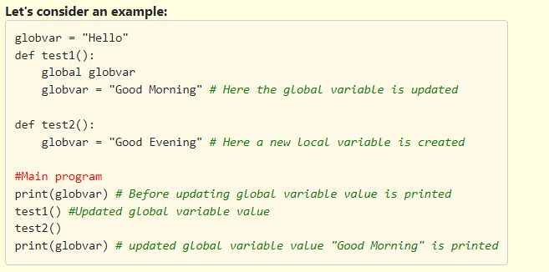

Slide 26
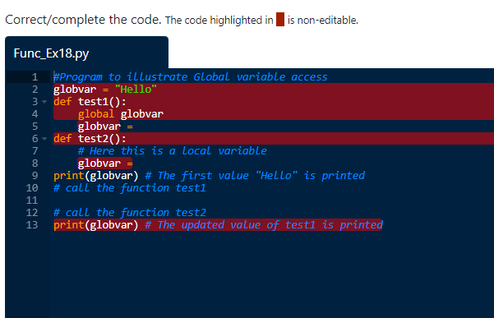

Follow these instructions and write the missing code in the below program.
Define a function test1()
Assign globvar = Good Morning
Define a function test2()
Assign globvar = Night Night
Call the function test1
Call the function test2
Note : Notice Calling test2 has no effect on the global globvar

Slide 27
Solution:
#Program to illustrate Global variable access
globvar = "Hello"
def test1():
global globvar
globvar = "Good Morning"
def test2():
# Here this is a local variable
globvar = "Night Night"
print(globvar) # The first value "Hello" is printed
test1()
test2()
print(globvar) # The updated value of test1 is printed

Slide 28
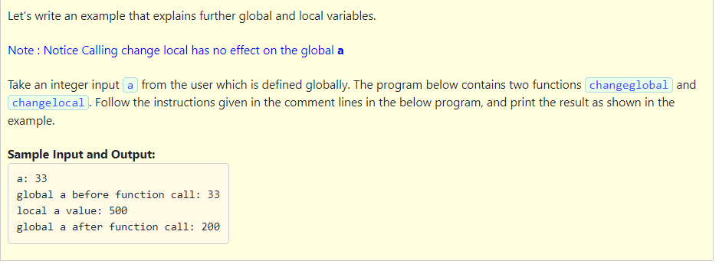
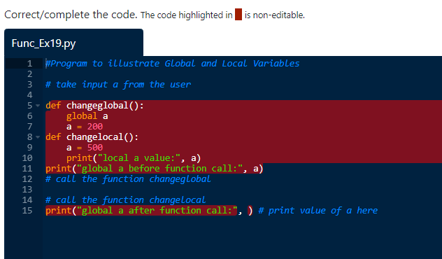

Slide 29
Solution:
#Program to illustrate Global and Local Variables
a = int(input("a: "))
def changeglobal():
global a
a = 200
def changelocal():
a = 500
print("local a value:", a)
print("global a before function call:", a)
changeglobal()
changelocal()
print("global a after function call:", a)

Slide 30
Function composition:
It combines functions in a way that the return value of each function is passed as an argument of the next function.
Let's consider an example:
Consider two functions f_1 and f_2.
Composition of two functions f_1 and f_2 is denoted f_1(f_2(x)).
x is the argument of f_2.
The return value of f_2 is passed as an argument to f_1.
The result of the composition is the return value of f_1.

Slide 31
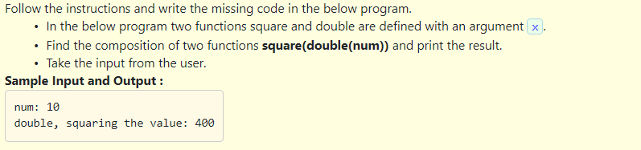
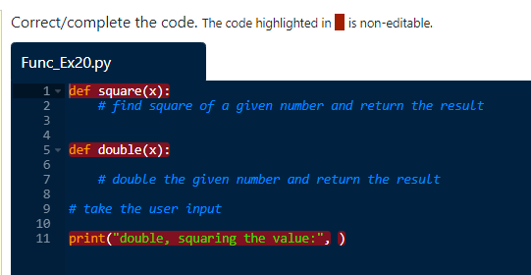

Slide 32
Solution:
def square(x):
x = x * x
return x
def double(x):
x = x * 2
return x
num = int(input("num: "))
print("double, squaring the value:", square(double(num)))

Slide 33
Write a program that uses function composition by following the steps given below.
Variable arguments are variable in length. These are used to pass a variable number of arguments to a function, this means that each time you call the function, you can pass any number of arguments to a function.
Here we pass arguments as functions. The functions have to be called in reverse order.

Slide 34
Solution:
def compose (*functions):
def inner(arg):
for f in reversed(functions):
arg = f(arg)
return arg
return inner
#Define three functions
def square (x):
return x ** 2
def increment (x):
return x + 1
def half (x):
return x / 2
# call with 3 functions
composed = compose(square, increment, half) # square(increment(half(x)))
print(composed(5)) # square(increment(half(5))) = square(increment(2.5)) = square(3.5) = 12.25# call with 2 functions
composed = compose(square, increment) #square(increment(5)) = square(6) = 36
print(composed(5))
Output:
12.25
36

